Slide 1
AWS-DMS
DATABASE MIGRATION SERVICE

Slide 2
content:
AWS DMS
Architecture of DMS
Prerequisites of AWS in DMS
Latest Versions using
Features of AWS DMS
Limitation of DMS
What are the engines supported by DMS
Difference between homogeneous and heterogeneous database
Latest things added in RDS and DMS

Slide 4
DATABASE MIGRATION SERVICE:
It is fully managed service offered by (aws),that help customer to migrate their DB into the AWS Cloud or between combinations of cloud and on-premises setups.
It supports variety of engine DB like MYSQL,PostgreSQL,Amazon Aurora,oracle,MSQL server...

Slide 5
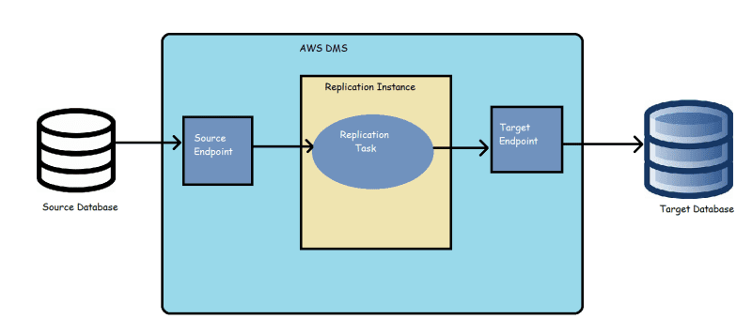
ARCHITECTURE OF AWS DMS:

Slide 6
Prerequisites of AWS in DMS:
Create a VPC.
Create a amazon RDS parameter groups.
Create your source amazon RDS database.
Create your target amazon RDS database.
Create an amazon EC2 client.
Populate your source database.

Slide 7
Latest Versions using in AWS DMS:
AWS DMS 3.5.0 is a beta version of the replication instance engine. AWS DMS supports this version the same as all previous releases. But we recommend that you test AWS DMS 3.5.0 Beta before using it for production purposes.
The 3.5.0 is still in testing purpose & the stable version is 3.4.7
In 3.4.7 they bought some new feature and some issue we resolved.

Slide 8
New features and issues resolved in AWS DMS:
Support SQL Server read replica as a source
Support VPC source and target endpoints
New PostgreSQL version
Support Aurora Serverless v2 as a target
Data loss with Amazon Redshift as a target

Slide 9
key features of DMS:
Replication: Replication of data is easy by setting source and the target DB.This enables to maintain an upto date copy of their in different location environment.
Transformation: Transform a data during migration to meet the target schema requirements,it allows us to modify data during the migraton.
Zero down time migration: It can perform a zero downtime migration of data by replicating the data changes to target DB.
multi-AZ deployment: which means that the service can automatically provision a replica of target db in a different availability zone for high availability and disaster recovery.
Monitoring and metrics: It provide real time monitoring and metrices through cloud watch,which enables customer to monitor and troubleshoot issues of DB.

Slide 10
LIMITATION OF DMS:
Limited support of DB types: this may not suitable for migrating all types of data
Limited control over the migration process: which can lead to some issue during the migration process.
Latency: It may have some latency during the migration process,which can impact the performance of the application.
Security limitations: Have some limitation on security which can make in unsuitable for certain use.
Highcost: For migrating the data the cost is bit high.

Slide 11
What are the engines supported by DMS:
Amazon RDS
Amazon S3
On-premisis DB
Other cloud provider
Amazon Redshift
Amazon Document DB
Amazon Dynamo DB

Slide 12
sources and targets engine DB that supports:
Sources:
Oracle , MySQL , MongoDB , SQL Server ,MariaDB
Targets:
Amazon S3, Amazon DynamoDB, Amazon Redshift , postgreSQL,
Amazon Aurora, MSQL Server , MySQL.

Slide 13
Difference between homogeneous and heterogeneous database:
HOMOGENEOUS :
Migrating data between same engine type.
migration is simple and easy.
Not feasible to migrate different DB Engine.
HETEROGENEOUS:
Migrating data between different engine type.
Migration is complex and requires addition step,such as data transformation and compability checks.
Allow you to move data between different DB types and version.

Slide 14
Latest things added in and DMS:
Aurora PosrtgreSQL 13 : It is highly performance and fully managed DB services.
Dms support for mongo DB and Amazon Document DB: This support customer to easily migrate data from those DB to other DB or data warehouse in the awcloud.
Dms continous data application: Amazon introduced continuous data replication, which allows customers to replicate change from a source DB to target DB.This can help reduce downtime during migration and enable real-time analytics.

Slide 15
Key resources needed for AWS DMS
Source and Target databases:
AWS DMS instance
AWS IAM role
Network connectivity
AWS S3 bucket
AWS CloudWatch Logs
AWS KMS

Slide 16
Quotas for AWS DMS
Maximum number of replication instances per AWS account: 10
Maximum number of replication tasks per AWS account: 50
Maximum number of tables per replication task: 500
Maximum table size per replication task: 64 terabytes (TB)
Maximum size of LOB (Large Object) data per replication task: 4GB
Maximum migration speed: 10 Gbps
Maximum number of endpoints per AWS account: 50

